Slide 1

분할정복

Slide 2
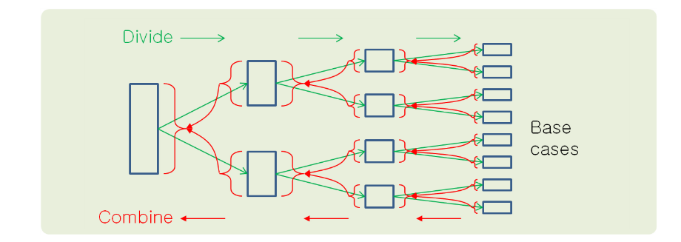
The divide-and-conquer design paradigm
Divide the problem (instance) into subproblems.
Conquer the subproblems by solving them recursively.
Combine subproblem solutions.

Slide 3
Method 1 : Sum (1~n)
sum from 1 ~ n
f(n) = sum from 1 ~ n
f(1) = 1
f(10)= 1 + 2 + 3 + 4 + 5 + 6 + 7 + 8 + 9 + 10
f(9) = 1 + 2 + 3 + 4 + 5 + 6 + 7 + 8 + 9
f(10) = f(9) + 10
f(n) = f(n - 1) + n
O(n)
def GetSome1(n):
if n==1: return 1
else: return GetSome1(n-1)+n

Slide 4

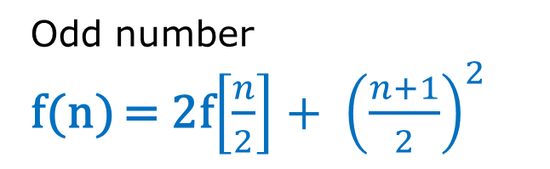
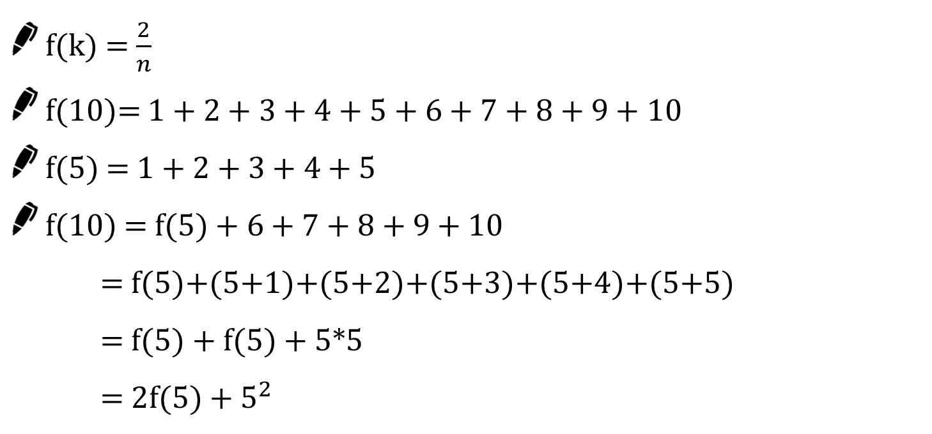
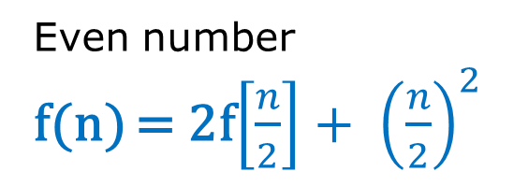
Method 2 Sum (1~n) n = 5
f(k) = $\frac{2}{n}$
f(10)= 1 + 2 + 3 + 4 + 5 + 6 + 7 + 8 + 9 + 10
f(5) = 1 + 2 + 3 + 4 + 5
f(10) = f(5) + 6 + 7 + 8 + 9 + 10
= f(5)+(5+1)+(5+2)+(5+3)+(5+4)+(5+5)
= f(5) + f(5) + 5*5
= 2f(5) + $5^{2}$
Even number
f(n) = 2f$\left[\frac{n}{2}\right]+ {\left(\frac{n}{2}\right)}^{2}$
Odd number
f(n) = 2f$\left[\frac{n}{2}\right]+ {\left(\frac{n+1}{2}\right)}^{2}$

Slide 5
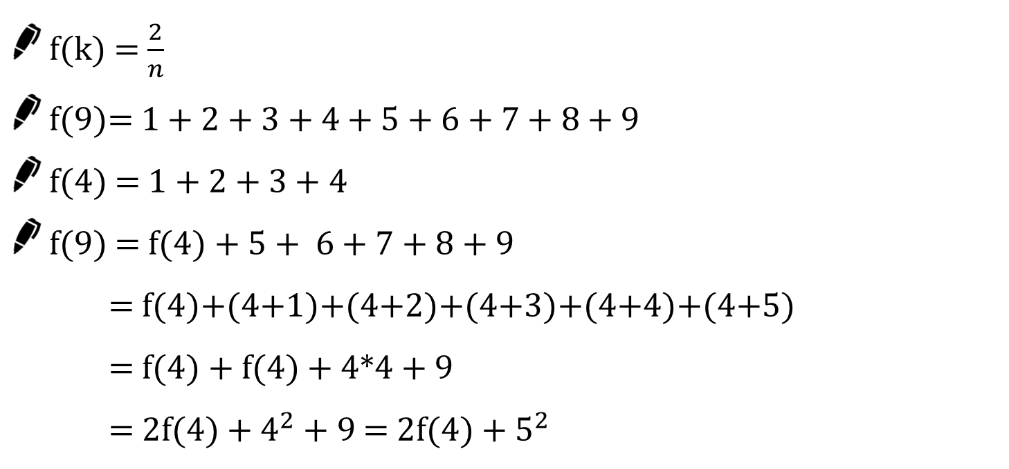
Method 2 Sum (1~n) n = 9
f(k) = $\frac{2}{n}$
f(9)= 1 + 2 + 3 + 4 + 5 + 6 + 7 + 8 + 9
f(4) = 1 + 2 + 3 + 4
f(9) = f(4) + 5 + 6 + 7 + 8 + 9
= f(4)+(4+1)+(4+2)+(4+3)+(4+4)+(4+5)
= f(4) + f(4) + 4*4 + 9
= 2f(4) + $4^{2}$ + 9 = 2f(4) + $5^{2}$
Even number
f(n) = 2f$\left[\frac{n}{2}\right]+ {\left(\frac{n}{2}\right)}^{2}$
Odd number
f(n) = 2f$\left[\frac{n}{2}\right]+ {\left(\frac{n+1}{2}\right)}^{2}$

Slide 6
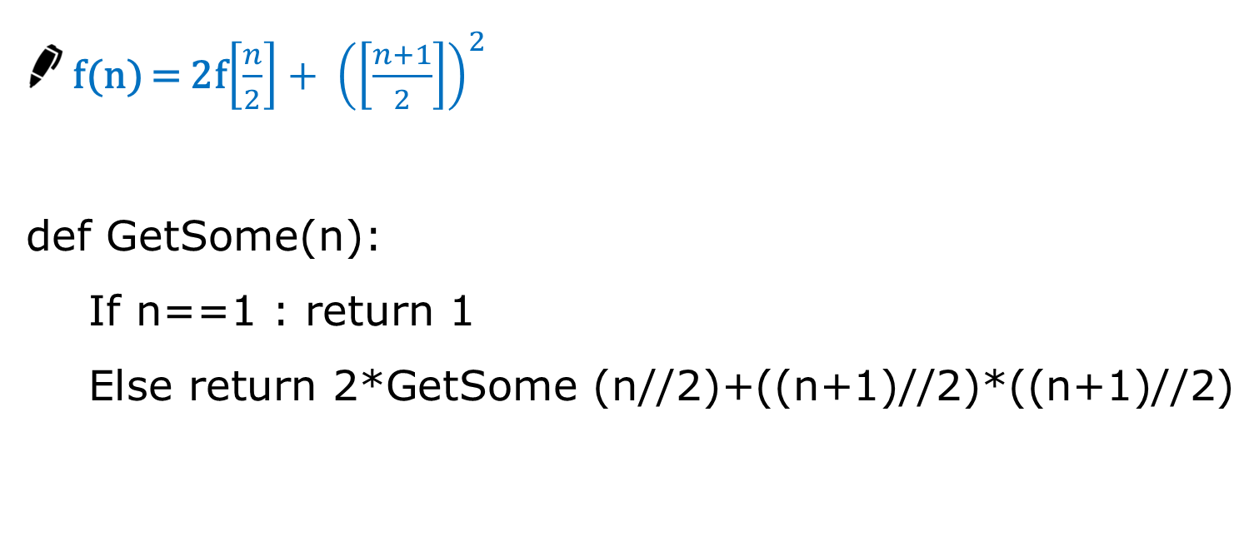
Method 2 Sum (1~n)
f(n) = 2f$\left[\frac{n}{2}\right]+ {\left(\left[\frac{n+1}{2}\right]\right)}^{2}$
def GetSome(n):
If n==1 : return 1
Else return 2*GetSome (n//2)+((n+1)//2)*((n+1)//2)
Divide and conquer Algorithm
O(logn)

Slide 7
Calculation count comparison
 | Data 1 | Data 2 | Data 3
Method 1 | 16 | 1024 | 32768
Method 2 | 4 | 10 | 17
Method 1 : O(n)
Method 2 : O(log n)

Slide 8
Drawing stars
Draw the triangle shaped stars.
INPUT n (1 ≤ n < 10,000)
OUTPUT Examples
n==3
*
**
***
n==5
*
**
***
****
*****

Slide 9

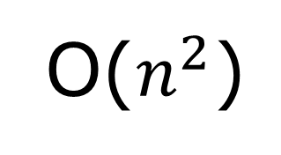
더 빠르게~
O($n^{2}\text{)}$
def GetSome(n):
if n>0:
GetSome(n-1)
for i in range(n)
print("*“, end=‘‘);
print()

Slide 10
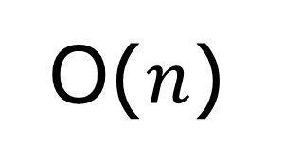
We need to be faster!!!!
star[10]
*
*
*
*
0 | 1 | 2 | 3 | 4 | 5 | 6 | 7 | 8 | 9
def GetSome(n):
if n > 0:
GetSome(n-1)
star.append('*')
print(star)
GetSome(5)
*
**
***
****
O($n\text{)}$

Slide 11

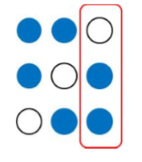
Combination C(n,r)
C(3, 2)

Slide 12
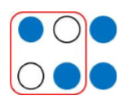

Combination C(n,r)
C(3, 2)
C(n, r) = C(n-1, r-1) + C(n-1, r)
Last item selected | Last item not selected

Slide 13


Combination
C(n,r) = $\left\{\begin{aligned}\text{1} \text{ (}\text{r}\text{==}\text{n}\text{) } \\ \text{n} \text{ (}\text{r}\text{==1}) \\ \text{C}\text{(}\text{n}\text{−1, }\text{r}\text{−1) + }\text{Combi}\text{(}\text{n}\text{−1, }\text{r}\text{) (1 < }\text{r}\text{ < }\text{n}\text{)}\end{aligned}\right.$
def Combi(n, r):
if r == n: return 1
elif r == 1: return n
else : return Combi(n - 1, r - 1) + Combi(n - 1, r)
O($2^{n}$)

Slide 14

Combination
Combi(n, r) = $\left\{\frac{n!}{r!\left(n−r\right)!}\right.$
Combi(n, r-1) = $\left\{\frac{n!}{(r−1)!\left(n−r+1\right)!}\right.$
C(n,r) = $\left\{\begin{aligned}\text{1 (}\text{r}\text{==}\text{n}\text{) } \\ \text{n}\text{ (}\text{r}\text{==1}) \\ \text{C}\text{(}\text{n}\text{, }\text{r}\text{−1) ∗ }\frac{n −r+1}{k}\text{(1 < }\text{r}\text{ < }\text{n}\text{)}\end{aligned}\right.$
O(n)

Slide 15
Combination
O(n)
def Combi2(n, r):
if r == n: return 1
elif r == 1: return n
else :
return Combi2(n,r-1)*(n-r+1)//r;

Slide 16
거듭 제곱
반복(Iterative) 알고리즘 : O(n)
Iterative_Power(x, n)
result ← 1
FOR i in 1 → n
result ← result * x
RETURN result

Slide 17
거듭 제곱
분할 정복 기반의 알고리즘 :
Recursive_Power(x, n)
IF n == 1 : RETURN x
IF n is even
y ← Recursive_Power(x, n/2)
RETURN y * y
ELSE
y ← Recursive_Power(x, (n-1)/2)
RETURN y * y * x

Slide 18
a^b O(n)
def Power1(a,b):
if b== 0 : return 1
elif b== 1 : return a
else : return a*Power2(a,b-1)

Slide 19
a^b O(logn)
def Power2(a, b):
if b== 0 : return 1
elif b== 1 : return a
elif b&1 : return a*Power1(a, b-1)
else :
temp = Power1(a, b//2)
return temp*temp

Slide 20

a^b using binarys
$3^{27}$
27 = 11011
$3^{27}$ = $3^{1} ∗ 3^{2} ∗ 3^{8} ∗ 3^{16}$

Slide 21
a^b $3^{27}$
11011
def Power3(a, b):
ans = 1
while b > 0 :
if b&1 : ans *=a
a = a*a
b//=2
return ans

